Slide 1
Rule 3.00
Game Preliminaries

Slide 2
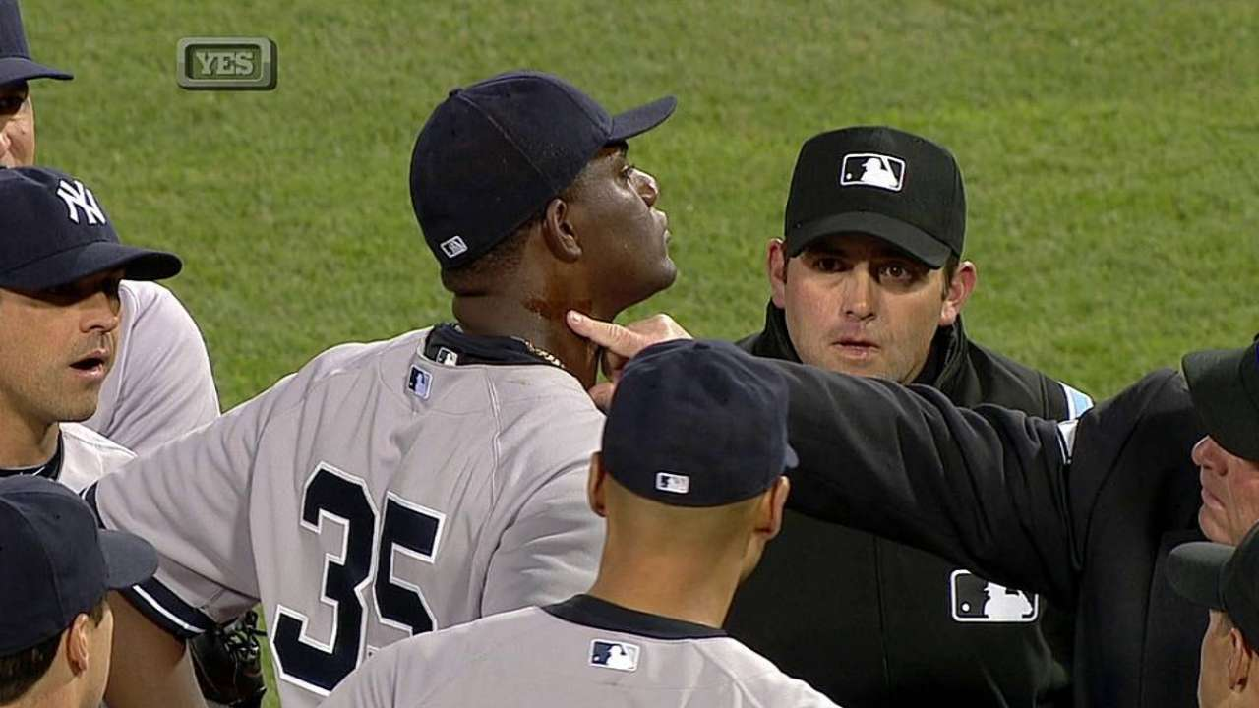
Rule 3.00
3.01 – Before the game begins the umpire(s) shall:
Require observance of all rules governing personnel, equipment and gameplay.
Make sure lines are drawn. If not, request lines as soon as you step on field.
Receive baseballs (minimum of 3) that meet specs.
Make sure the teams have additional baseballs to keep the game moving.
3.02 – Players may not intentionally discolor or damage the baseball.
Penalty – Remove the ball from the game. Remove the pitcher from the position, not the game.
It is strongly recommended that a warning be given first before enforcement.

Slide 3
Rule 3.00
3.03 – Substitution rules
Mandatory play
Starters – 6 defensive outs, 1 at bat. Does not have to be consecutive.
Substitutes – 6 CONSECUTIVE defensive outs, 1 at bat.
Starters may re-enter the game once in any spot in the batting order.
Starters cannot re-enter until their sub has met mandatory play.
Subs may not re-enter once removed. Subs also may not be removed until mandatory play is completed.
Major baseball – Pitchers may not return to the mound during the game.
Jr/Sr baseball – Pitchers may return to the mound one time.
They keep their existing pitch count.
They keep their visit count. If they have already reached 4 visits, they are ineligible.
Defensive substitutions take place on defense. Offensive subs on offense.
Offensive subs happen when the player enters the batter’s box or is on base (pinch runner)

Slide 4
Rule 3.00
3.03 – Sr Baseball DH Rule
DH’s are allowed. DH must meet mandatory play requirements. That means the DH will be removed during the game if used.
DH is not eligible for 7.14 Special Pinch Runner.
When the DH moves to the field, they will keep their spot in the batting order. Player being hit for must be removed. When that player returns, they must take the spot of the former DH in the order.
3.03 General Note: When a team cannot field 9 players due to injury, illness, or ejection, the opposing team shall select an ineligible player to return to the lineup, except for ejected players.

Slide 5
Rule 3.00
3.04 – Courtesy Runners are not allowed. Use 7.14.
3.05 – The starting pitcher must pitch to the first batter unless illness, injury, ejection. If one of those apply, the sub must pitch to the first batter unless injury, illness, ejection. And so on….
3.06 – The manager shall immediately announce any substitution(s) to the umpire.
3.07 – The umpire shall immediately announce the substitution(s).
3.08 – If no announcement of a sub, they are to be considered official when:
The defensive player takes the field and play resumes.
When the batter enters the box.
When the pitcher throws one warm up pitch.
When a runner takes the player’s place on a base.

Slide 6
Rule 3.00
3.09 – Managers, Coaches, and players may not address the crowd or mingle/sit with spectators.
3.09 – Managers and Coaches may not warm up pitchers. They may stand in the bullpen to observe provided an adult is in the dugout.
3.10 (a) – Both managers shall agree on the condition of the playing field before the game starts.
3.10 (b) – The UIC shall be the sole judge of playing conditions and when to suspend/resume play AFTER the game begins. For DSUA purposes, this is defined as the beginning of the manager’s meeting.
COMMON SENSE MUST PREVAIL!!! SAFETY FIRST!!!

Slide 7
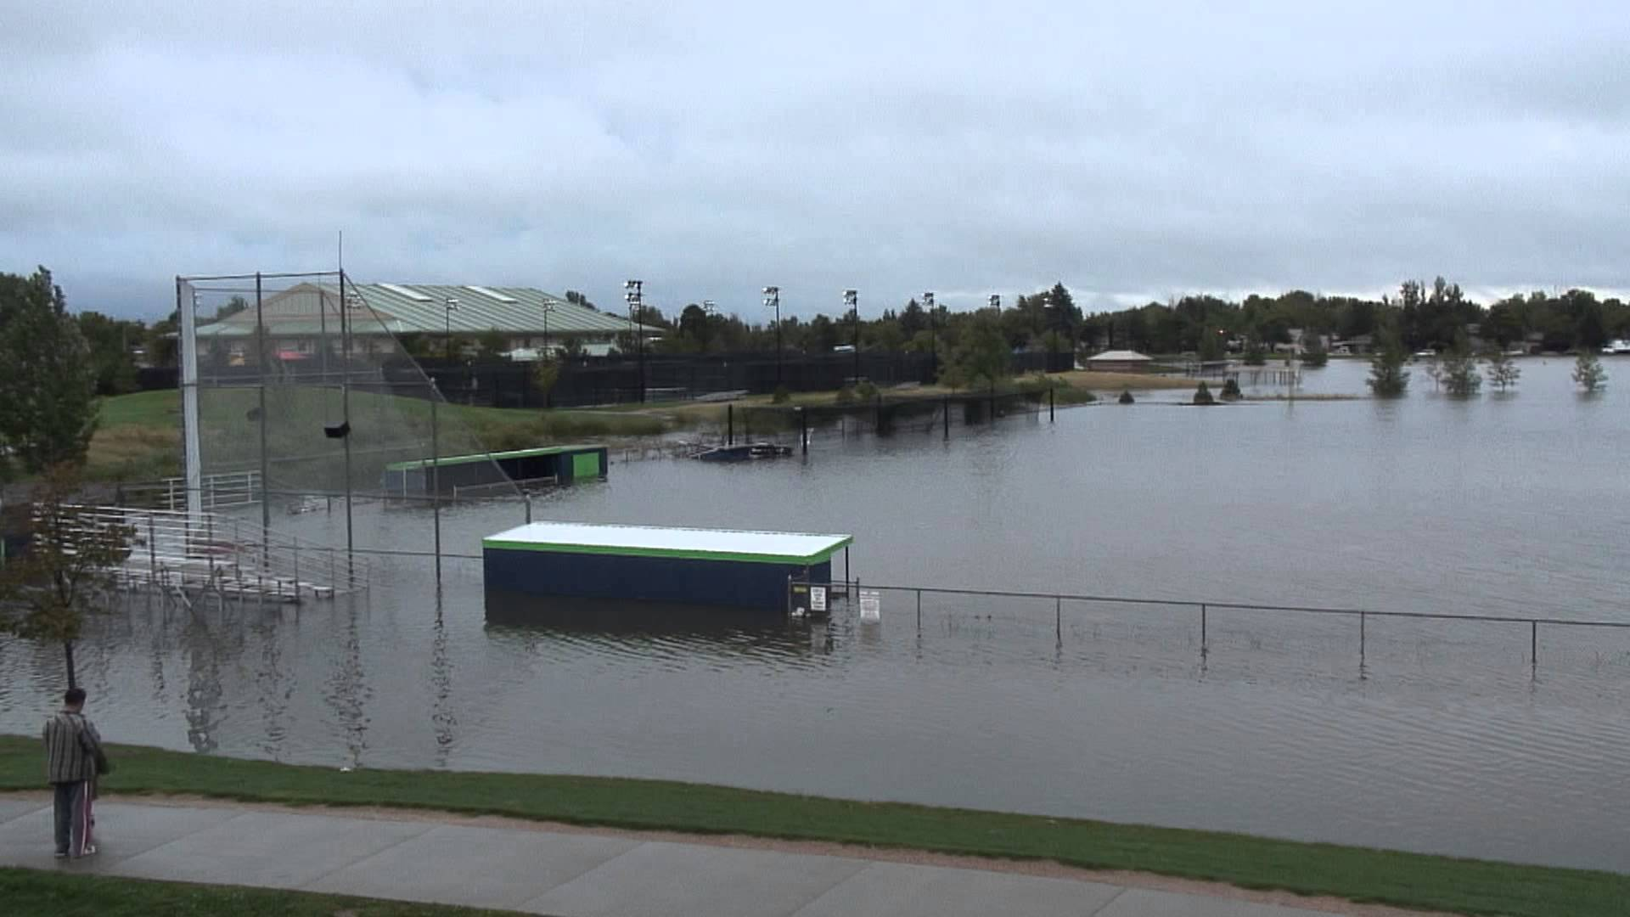
You’re probably not playing today…

Slide 8
Rule 3.00
3.10 DSUA clarification
Work with managers. It is ok to let them know your opinion of the field and to point out areas of concern.
Do not work on the field. LL insurance will not cover you.
Use common sense when identifying a starting time with the managers, considering curfew times on lighted fields or darkness on unlit fields.
DSUA weather policies -
Umpires will be paid their full game fee once one pitch is thrown.
Umpires shall not charge a game fee if the weather arrives before game time and play cannot begin.
If significant rain has fallen well ahead of game time, the umpire(s) arrive and nobody is on site, and the assignor was not called, a fee may be charged.
Plate umpire - Inform the assignor of the status of the game ASAP.

Slide 9
Rule 3.00
3.11 – Double Headers
Major baseball – 1 per calendar week. No triple headers.
Jr/Sr – no restrictions
NOTE: DH’s are defined as 2 full games. Suspended games are not considered part of a DH.
3.12 – Suspended Play/Defining when the ball is dead.
The umpire shall suspend play by calling “Time.” A suspension will be lifted when the umpire calls “Play.”
3.13 – The local league/interleague will establish local ground rules.
Ground rules will be discussed in pregame meeting.
3.14 – All equipment will be removed from the field when not in use.
When on deck areas are on the field, demand areas are kept clear
No catchers equipment or gloves should be left in foul territory.

Slide 10
Rule 3.00
3.15 – Players, Coaches, Umpires and approved media are the only people allowed on the field.
If intentional interference is made by any of these people, the ball is dead and penalties shall be applied. Unintentional interference, allow play to continue.
3.16 – Spectator Interference
Can apply to a batted or thrown ball
Ball is dead at the moment of interference.
Umpires shall impose penalties to nullify act of interference.
If a player could have made a catch before spectator interference, the umpire shall declare the batter out.

Slide 11
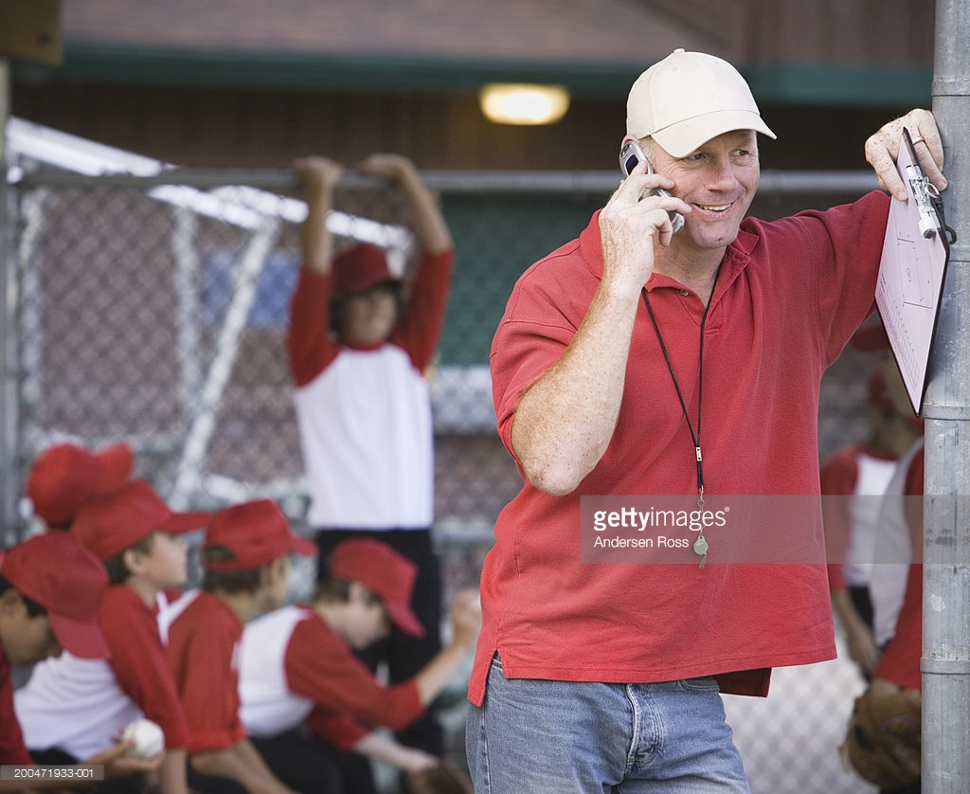
Rule 3.00
3.17 – No more than a manager, 2 coaches, and eligible players may occupy the dugout. No team moms, bat boys, league officials, etc.
Define the dugout if there are questions (ex. Midway, city/county fields.)
3.17 – Electronic communication devices (DE 2 Interleague Definitions)
Tablets are ok for electronic scoring.
Use of any device in a coach’s box or on the field is immediate ejection.
Adults may have cell phones but cannot abuse the privilege.

Slide 12
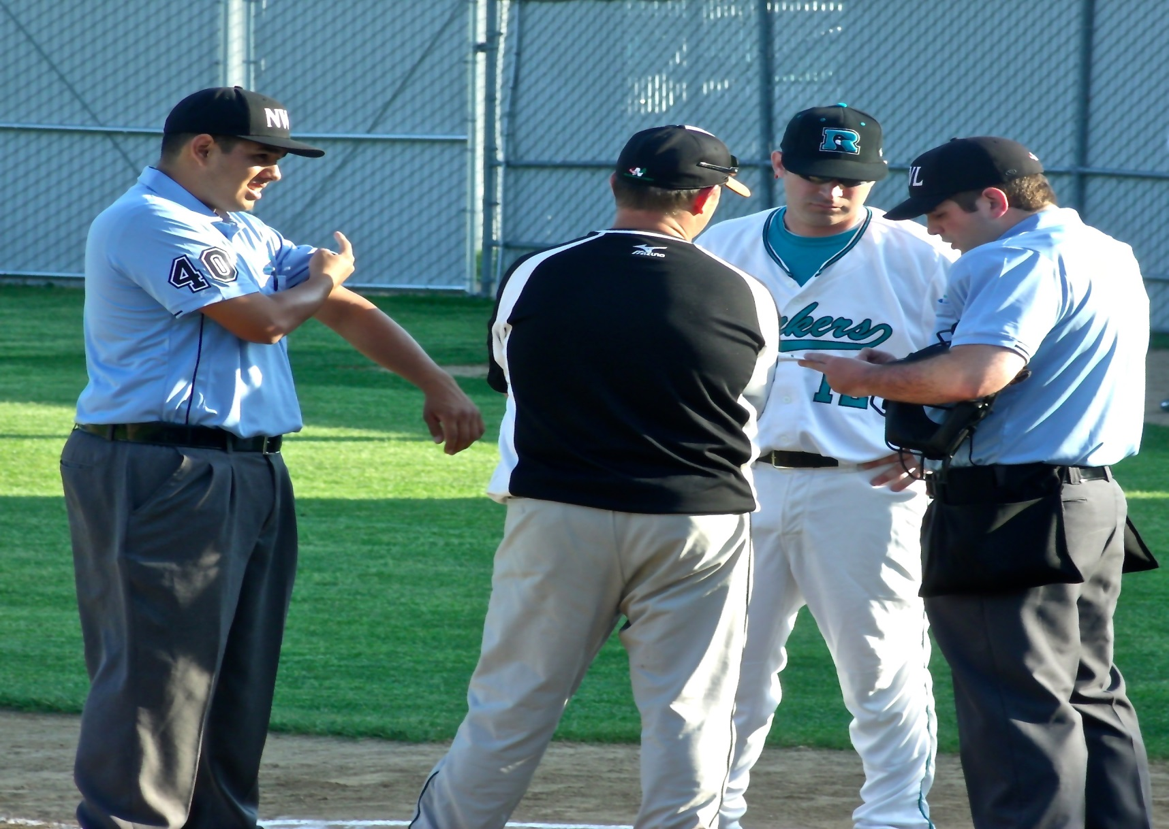
PRE GAME MANAGER MEETING

Slide 13
Pregame Manager Meeting
Script
Plate Umpire will conduct pregame meeting. Meeting should start 5-10 minutes before game time. Be on the field a few minutes before meeting.
Speak assertively but come off as approachable.
Introductions
If not completed, fill out voucher. Have both managers sign.
Remind managers, by signing voucher you certify all players are legal and properly equipped within the rules.
Review local field ground rules with host manager.
Define any unclear ground rules (i.e. Dyer wire, Wilmington on deck area)
Review points of emphasis (jewelry, throwing equipment, foul language, etc)
Shake hands and break. Instruct the defense to take the field ASAP.
After meeting, communicate with partner any last minute items of emphasis.

